Slide 1
Netflix a popularity contest or something more?
Orlando Fuller, Eric Linn, Sania Lari, Jacob Johnson

Slide 2
Objectives
To incorporate our knowledge on Machine Learning, NLP, and AWS into a functional project that provides the audience with knowledge previously unknown

Slide 3
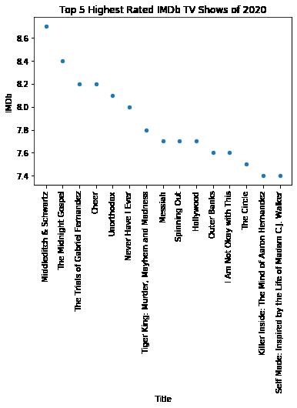
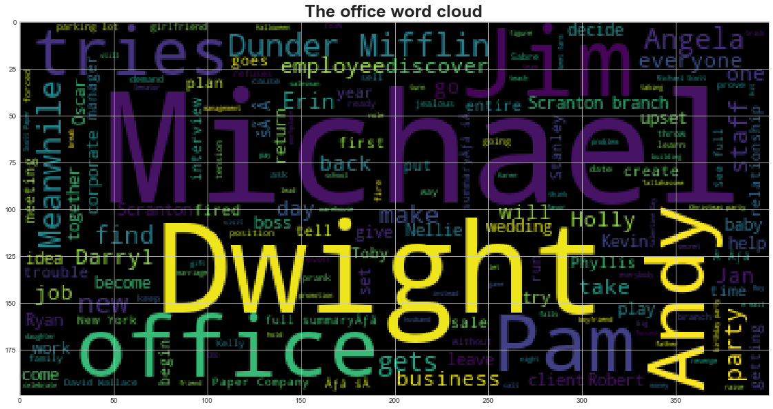
Hypothesis
IMDB ratings have a direct correlation on the viewership on Netflix
Viewership per episode increased based on viewers favorite character in the title

Slide 4
Top 5 titles of the 2000s
As demonstrated by the BOT to the right hand side you are capable of asking for recommendations based on the year and what was the most popular title available on Netflix based on IMDB ratings

Slide 5
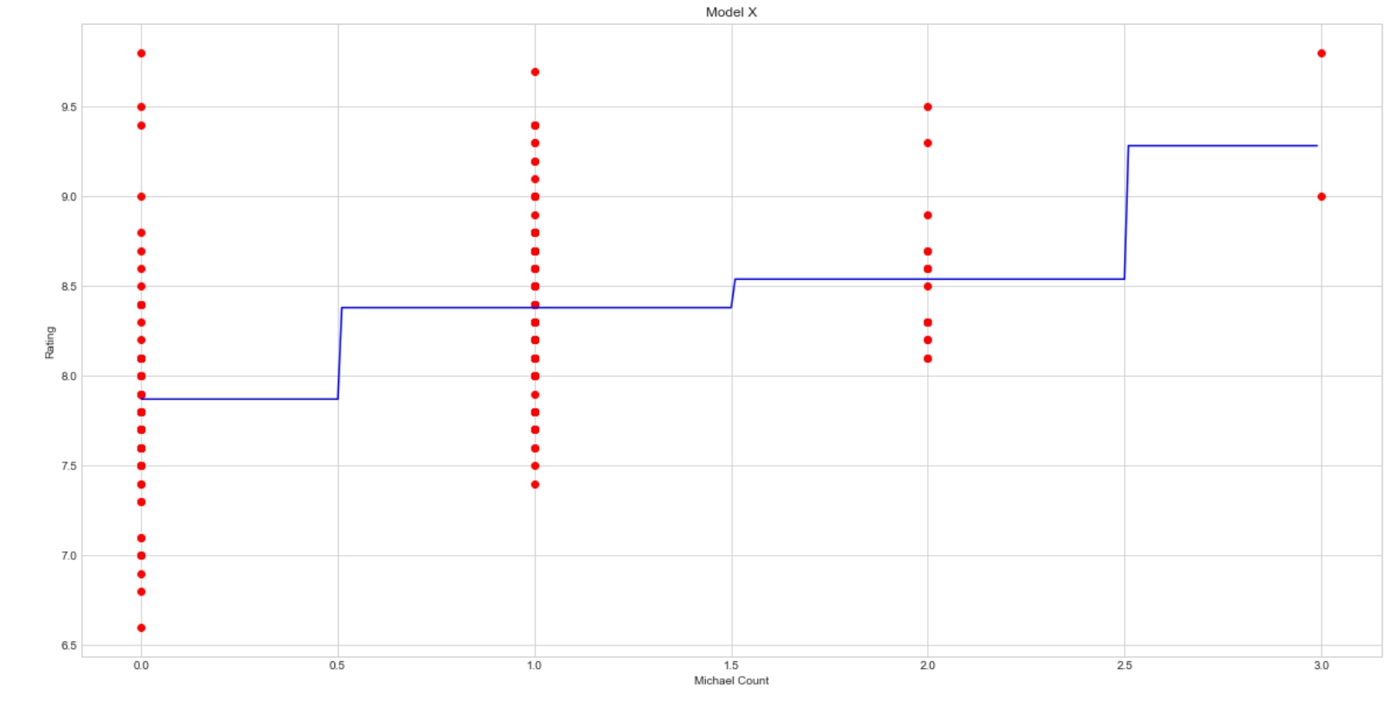
Sentiment Analysis of the Office
The correlation between the times that Michael was mentioned and the rating of the episode was higher than the average rating of the show if he wasn’t mentioned
Adding in additional characters to the model we could see that the combination of Michael and Dwight resulted in overall higher ratings

Slide 6
Trends of Ratings of a Show

